Slide 1
Data Drive Fracture Mechanics: Discovering Elastic Constants and Failure Criteria using PINNs
Thomas Allard
Samantha Walker
April 26, 2022

Slide 2
Outline
The fastest introduction you’ll ever get
Background – Elasticity and Fracture Mechanics
Input Data – Abaqus Simulations
Background – PINNs
Elastic PINN
Fracture PINN
Conclusions
References

Slide 3
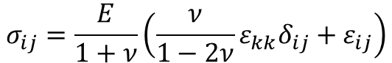
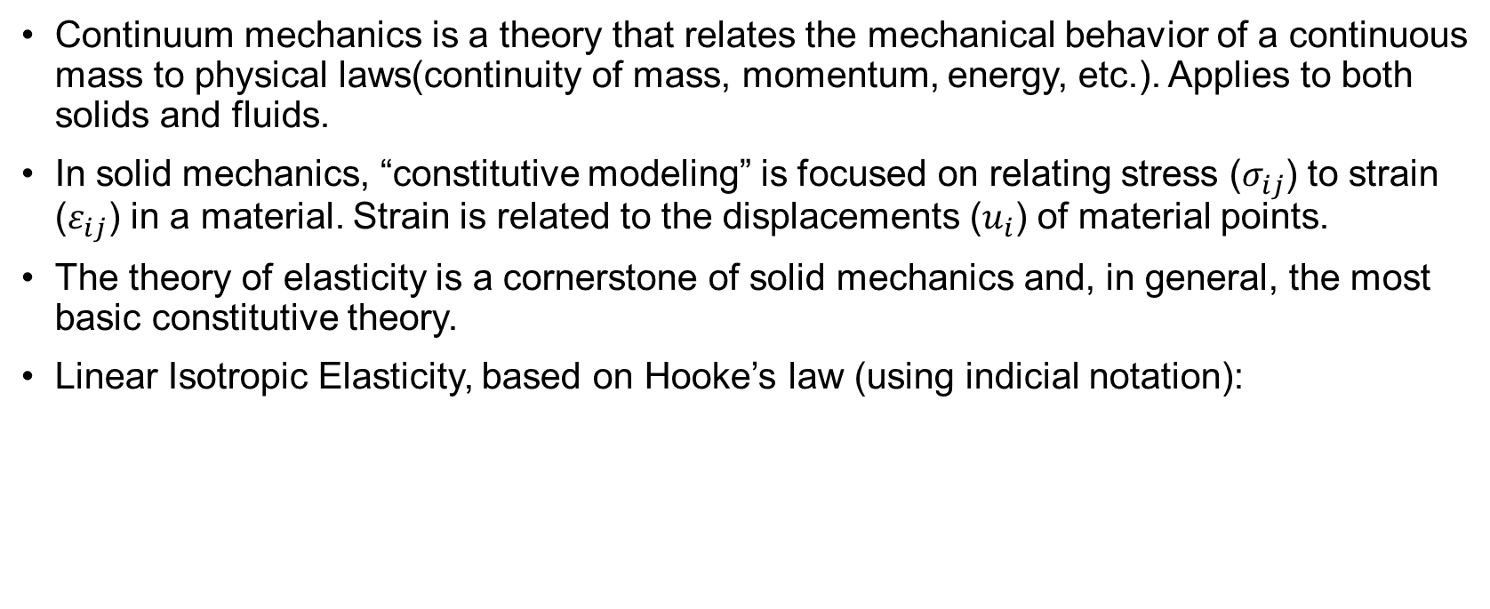
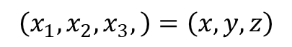
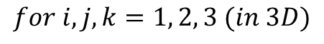

Background – Elasticity
Continuum mechanics is a theory that relates the mechanical behavior of a continuous mass to physical laws(continuity of mass, momentum, energy, etc.). Applies to both solids and fluids.
In solid mechanics, “constitutive modeling” is focused on relating stress ($σ_{ij}$) to strain ($ε_{ij}$) in a material. Strain is related to the displacements ($u_{i}$) of material points.
The theory of elasticity is a cornerstone of solid mechanics and, in general, the most basic constitutive theory.
Linear Isotropic Elasticity, based on Hooke’s law (using indicial notation):
$$σ_{ij}=\frac{E}{1+ν}\left(\frac{ν}{1−2ν}ε_{kk}δ_{ij}+ε_{ij}\right)$$
$$ε_{ij}=\frac{1}{2}\left(\frac{∂u_{i}}{∂x_{j}}+\frac{∂u_{j}}{∂x_{i}}\right)$$
$$\left(x_{1},x_{2},x_{3},\right)=\left(x,y,z\right)$$
$$for i,j,k=1, 2, 3 (in 3D)$$
E = Elastic Modulus
ν = Poisson’s Ratio

Slide 4
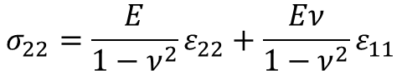

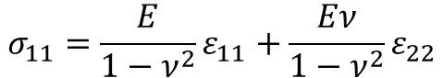
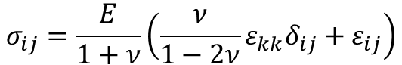
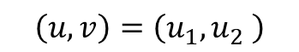

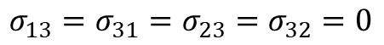
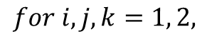
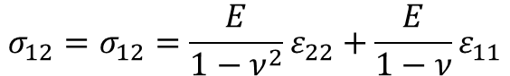
Background – Elasticity (2D)
$$σ_{ij}=\frac{E}{1+ν}\left(\frac{ν}{1−2ν}ε_{kk}δ_{ij}+ε_{ij}\right)$$
$$ε_{ij}=\frac{1}{2}\left(\frac{∂u_{i}}{∂x_{j}}+\frac{∂u_{j}}{∂x_{i}}\right)$$
$$\left(x_{1},x_{2} \right)=\left(x,y\right)$$
$$for i,j,k=1, 2,$$
$$\left(u,v\right)=\left(u_{1},u_{2} \right)$$
2D Plane Strain:
$$σ_{11}=\frac{E}{1−ν^{2}}ε_{11}+\frac{Eν}{1−ν^{2}}ε_{22}$$
$$σ_{22}=\frac{E}{1−ν^{2}}ε_{22}+\frac{Eν}{1−ν^{2}}ε_{11}$$
$$σ_{12}=σ_{12}=\frac{E}{1−ν^{2}}ε_{22}+\frac{E}{1−ν}ε_{11}$$
$$σ_{13}=σ_{31}=σ_{23}=σ_{32}=0$$
$$σ_{33}=ν\left(σ_{11}+σ_{22}\right)$$

Slide 5
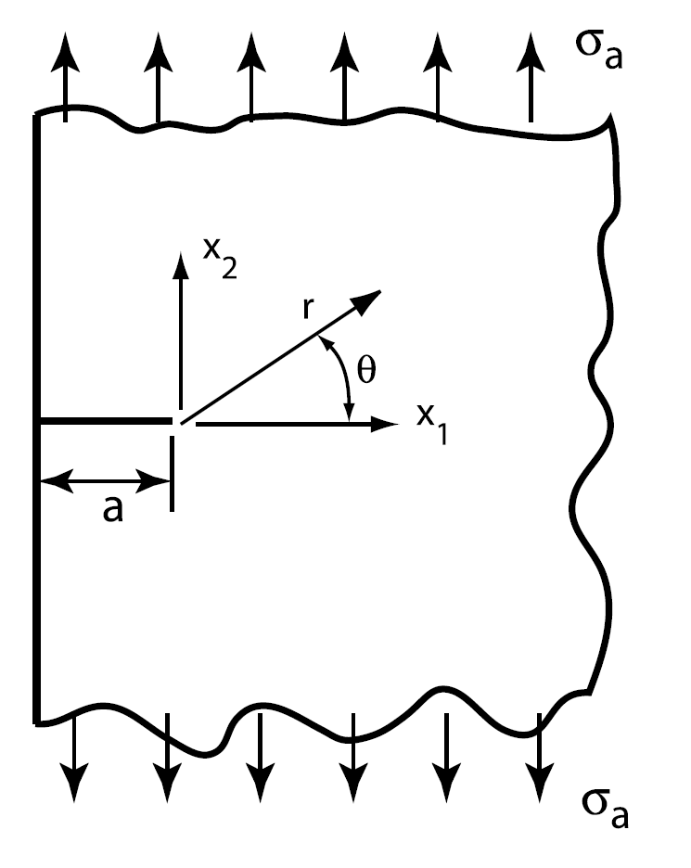
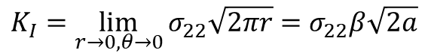
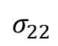
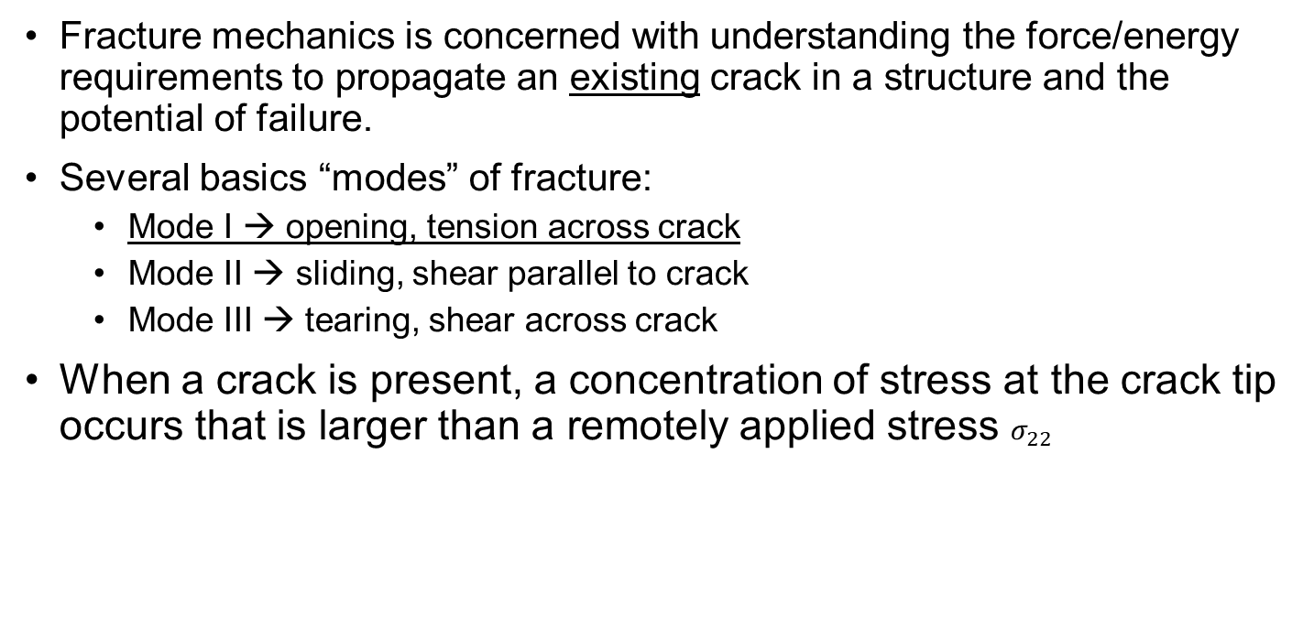
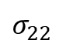
Background – Fracture Mechanics
$$σ_{22}$$
Fracture mechanics is concerned with understanding the force/energy requirements to propagate an existing crack in a structure and the potential of failure.
Several basics “modes” of fracture:
Mode I → opening, tension across crack
Mode II → sliding, shear parallel to crack
Mode III → tearing, shear across crack
When a crack is present, a concentration of stress at the crack tip occurs that is larger than a remotely applied stress $σ_{22}$
Focus of this project!
$$σ_{22}$$
$$K_{I}=\lim_{r→0,θ→0}{σ_{22}\sqrt{2πr}=σ_{22}β\sqrt{2a}}$$
Zehnder [1]
$β$ is a shape parameter that depends on geometry

Slide 6
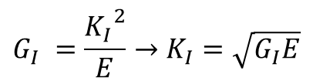
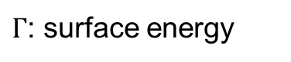
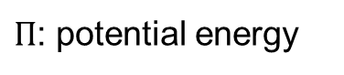
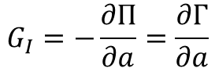
Background – Fracture Mechanics
$$σ_{22}$$
Linear Elastic Fracture Mechanics (LEFM) can also be derived through thermodynamics and energy methods, giving the energy release rate (for a brittle material):
It requires energy to propagate a crack and create a larger crack surface!
In LEFM, the energy release rate is exactly related to the stress intensity factor:
$$G_{I}=−\frac{∂Π}{∂a}=\frac{∂Γ}{∂a}$$
$Π$: potential energy
$Γ$: surface energy
$$σ_{22}$$
Zehnder [1]
$$G_{I} =\frac{{K_{I}}^{2}}{E}→K_{I}=\sqrt{G_{I}E}$$

Slide 7


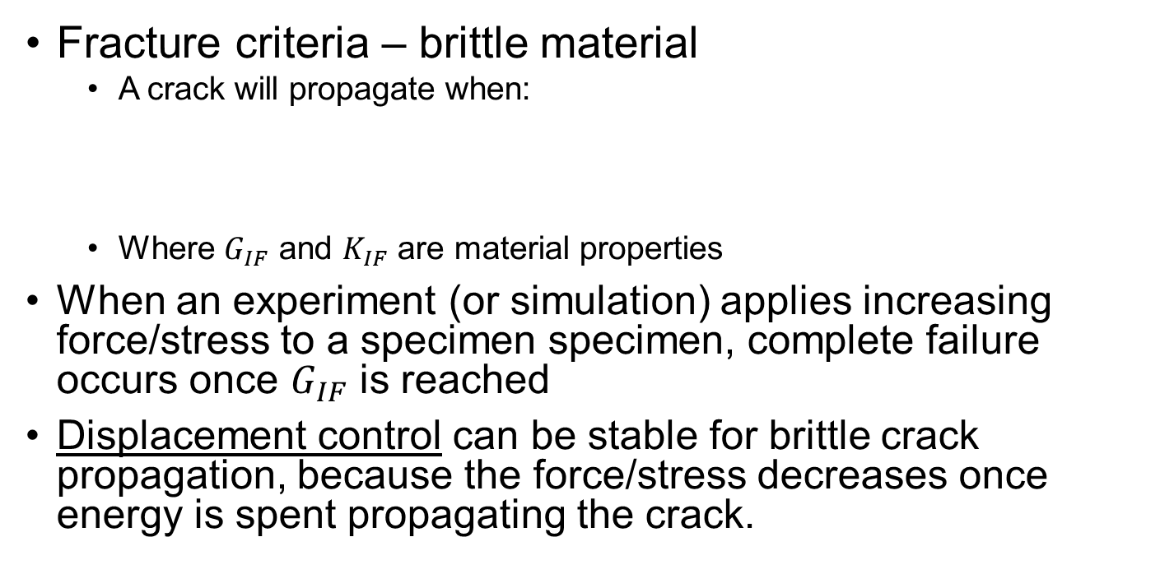
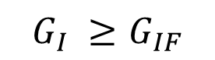
Background – Fracture Mechanics
$$σ_{22}$$
Fracture criteria – brittle material
A crack will propagate when:
Where $G_{IF}$ and $K_{IF}$ are material properties
When an experiment (or simulation) applies increasing force/stress to a specimen specimen, complete failure occurs once $G_{IF}$ is reached
Displacement control can be stable for brittle crack propagation, because the force/stress decreases once energy is spent propagating the crack.
$$G_{I} ≥G_{IF}$$
$$or$$
$$K_{I} ≥K_{IF}$$
$$σ_{22}$$
Zehnder [1]

Slide 8
Background – Data Driven Fracture Mechanics
Many studies have been conducted investigating data-driven constitutive model calibration and discovery:
[2] E. Haghighat, M. Raissi, A. Moure, H. Gomez, and R. James. “A Deep Learning Framework for Solution and Discovery in Solid Mechanics.” 2020, arXiv:2003.02751. URL http://arxiv.org/abs/2003.02751
[3] M. Raissi, P. Perdikaris, and G.E. Karniadakis. “Physics-informed neural networks: A deep learning framework for solving forward and inverse problems using nonlinear partial differential equations.” 2019, Journal of Computational Physics
[4] Z. Wang, X. Huan, and K. Garikipati. “Variational system identification of the partial differential equations governing the physics of pattern-formation: Inference under varying fidelity and noise.” 2019.
[5] Moritz Flaschel, Siddhang Kumar, and Larua De Lorenzis. “Unsupervised discovery of interpretable constitutive laws.” 2021, Computational Methods in Applied Mechanics and Engineering.
[6] Nikolaos N. Vlassis, Ran Ma, and WaiChing Sun. “Geometric deep learning for computational mechanics Part I: anisotropic hyperelasticity.” 2020, Computer Methods in Applied Mechanics and Engineering.
[7] Nikolaos N. Vlassis and WaiChing Sun. “Component-based Machine Learning Paradigm for Discovering Rate-dependent and pressure-sensitive Level-set Plasticity Models.” 2021, ASME Journal of Applied Mechanics.
Only several studies have applied data-driven methods to fracture mechanics with limited applicability to general situations/experiments:
[8] P. Carrara, L. De Lorenzis, L. Stainier, and M. Ortiz. “Data-driven fracture mechanics.” 2020, Computational Methods in Applied Mechanics and Engineering.
[9] P. Carrara, M. Ortiz, and L. De Lorenzis. “Data-driven rate-dependent fracture mechanics.” 2021, Journal of Mechanics and Physics of Solids.
[10] Yinan Wang, Diane Oyen, Weihong Guo, Anishi Mehta, Cory Braker Scott, Nishant Panda, M. Giselle Fernandez-Godino, Gowri Srinivasan, and Xiaowei Yue. “StressNet – Deep learning to predict stress with fracture propagation in brittle materials.” 2021, Nature partner journal of Materials Degradation.

Slide 9
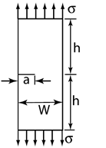
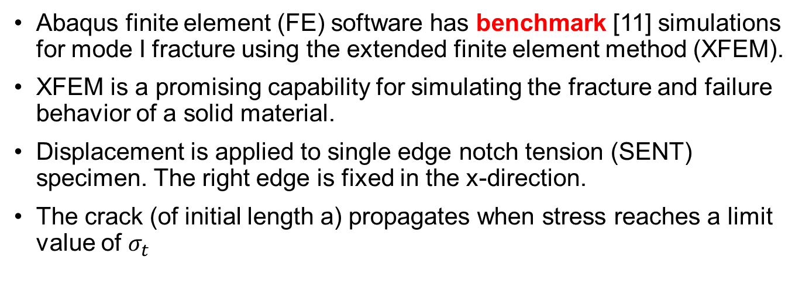
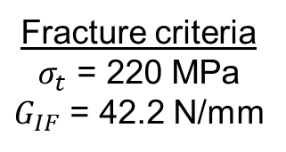
Input Data – Abaqus Simulations
u
Abaqus finite element (FE) software has benchmark [11] simulations for mode I fracture using the extended finite element method (XFEM).
XFEM is a promising capability for simulating the fracture and failure behavior of a solid material.
Displacement is applied to single edge notch tension (SENT) specimen. The right edge is fixed in the x-direction.
The crack (of initial length a) propagates when stress reaches a limit value of $σ_{t}$
a = 300 mm
h = 1500 mm
W = 3000 mm
u = 1 mm
Elastic Modulus
Elastic parameters
E = 210 GPa
ν = 0.3
Fracture criteria
$σ_{t}$ = 220 MPa
$G_{IF}$ = 42.2 N/mm
Max tensile stress
u
Zehnder [1]
Poisson’s Ratio
Mode I fracture energy release rate

Slide 10
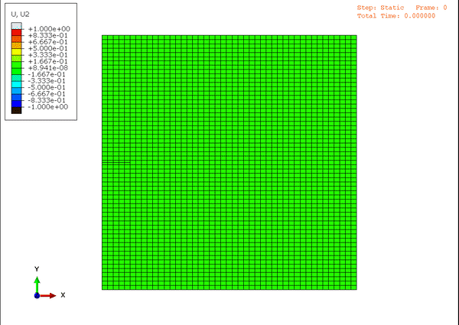
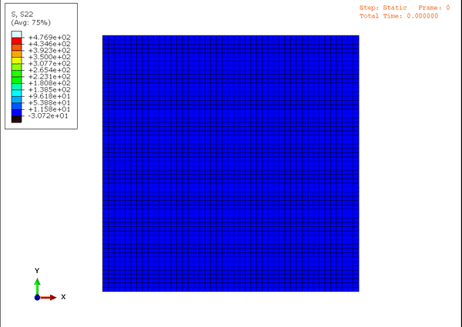
Input Data – Abaqus Fracture
u
a = 300 mm
h = 1500 mm
W = 3000 mm
u = 1 mm
Default mesh, 2655 elements and 2760 nodes
u
Zehnder [1]
Deformed geometry is exaggerated by 100x

Slide 11
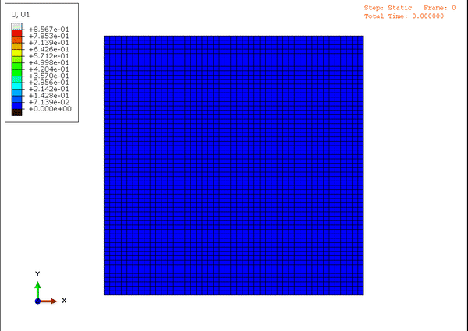

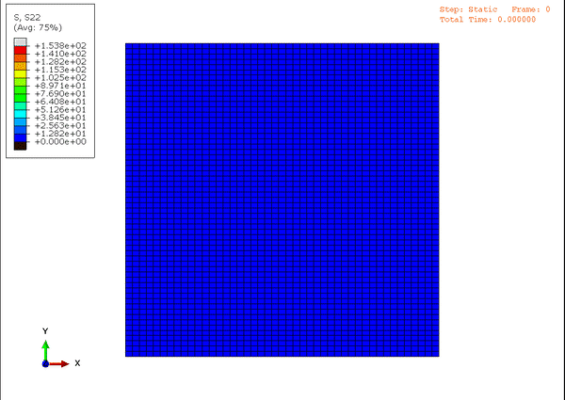
Input Data – Abaqus Elastic
h = 1500 mm
W = 3000 mm
u = 1 mm
Before developing a PINN for the fracture problem, we decided we would try a simpler problem.
Crack removed, all other dimensions and simulations parameters were kept the same.
Pure uniaxial stress state!

Slide 12
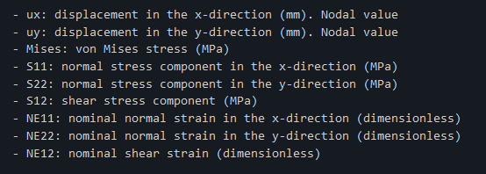
Input Data Extraction and MGMT
Abaqus/Python API to extract results from Abaqus output database (ODB)
Xarray “DataArray” for each timestep → stack into “DataSet”
Fields:

Slide 13
Background - PINNs
General – borrow from old slides
Sciann
Why??? Lol Yang *shrugs* → they actually have great examples! We used
https://github.com/sciann/sciann-applications
Data – (maybe move to end of Abaqus discussion)
Abaqus output database (ODB) extraction
Used xarray data formats (DataSets and DataArrays) to conveniently store and call simulation data, netcdf file
Hyperparameters
Started from sciann-applications
Tested different normalizations

Slide 14
Elastic PINN
Some outputs and plots
Troubles! ☹

Slide 15
Fracture PINN
Technically no trouble! (cuz we didn’t get here yet lol)
Ambitious goals

Slide 16
Conclusions
Why NNs so hard ☹

Slide 17
References
[1] Alan T. Zehnder. “Fracture Mechanics: Lecture Notes in Applied and Computational Mechanics.” 2012, Springer.
[2] E. Haghighat, M. Raissi, A. Moure, H. Gomez, and R. James. “A Deep Learning Framework for Solution and Discovery in Solid Mechanics.” 2020, arXiv:2003.02751. URL http://arxiv.org/abs/2003.02751
[3] M. Raissi, P. Perdikaris, and G.E. Karniadakis. “Physics-informed neural networks: A deep learning framework for solving forward and inverse problems using nonlinear partial differential equations.” 2019, Journal of Computational Physics
[4] Z. Wang, X. Huan, and K. Garikipati. “Variational system identification of the partial differential equations governing the physics of pattern-formation: Inference under varying fidelity and noise.” 2019.
[5] Moritz Flaschel, Siddhang Kumar, and Larua De Lorenzis. “Unsupervised discovery of interpretable constitutive laws.” 2021, Computational Methods in Applied Mechanics and Engineering.
[6] Nikolaos N. Vlassis, Ran Ma, and WaiChing Sun. “Geometric deep learning for computational mechanics Part I: anisotropic hyperelasticity.” 2020, Computer Methods in Applied Mechanics and Engineering.
[7] Nikolaos N. Vlassis and WaiChing Sun. “Component-based Machine Learning Paradigm for Discovering Rate-dependent and pressure-sensitive Level-set Plasticity Models.” 2021, ASME Journal of Applied Mechanics.
[8] P. Carrara, L. De Lorenzis, L. Stainier, and M. Ortiz. “Data-driven fracture mechanics.” 2020, Computational Methods in Applied Mechanics and Engineering.
[9] P. Carrara, M. Ortiz, and L. De Lorenzis. “Data-driven rate-dependent fracture mechanics.” 2021, Journal of Mechanics and Physics of Solids.
[10] Yinan Wang, Diane Oyen, Weihong Guo, Anishi Mehta, Cory Braker Scott, Nishant Panda, M. Giselle Fernandez-Godino, Gowri Srinivasan, and Xiaowei Yue. “StressNet – Deep learning to predict stress with fracture propagation in brittle materials.” 2021, Nature partner journal of Materials Degradation.
[11] Abaqus Benchmarks Guide, section 1.19.1 “Crack propagation of a single-edge notch simulated using XFEM.” 2016

